Slide 1
Connected Insurance – Construction Site
Point of View Discussion and Next Steps..

Slide 2
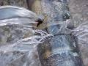
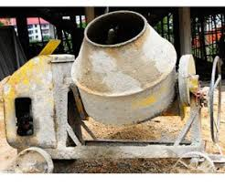
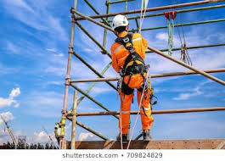
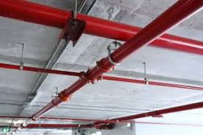
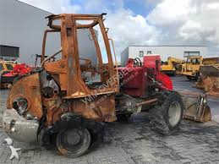

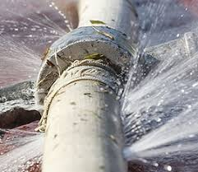
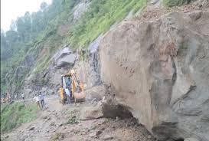
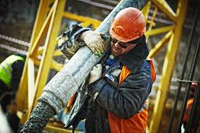
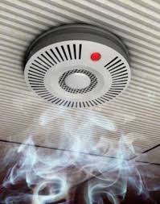
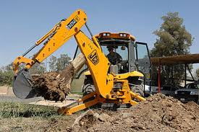


Construction site possible claim scenarios..
Buildings & structures
Construction Site Equipment
Construction Site Workers
Interior plumbing
Valves left open
Incomplete plumbing connections
Faulty workmanship
Damage while transporting or operating he equipment
Workers on high rise buildings without safety belt / helmets / jackets
Leakage from fire suppression system
Equipment Damage due to fire accidents
Working overtime leads to fatigue and accidents
Bust due to pipe freezes
Damage due to unfavorable weather conditions
Carrying weight more than recommended leads to health issues
Potential Smoke/ Fire damages
Stolen
equipment
Unsafe working condition leads to slip and fall
CCTV Camera Feeds
Insurance companies require connected digital ecosystem to track the real time site conditions to reduce the preventable claims, to optimize the cost , reduce the customer churns and enhance the customer engagement

Slide 3







Connected Insurance Ecosystem (partners, platform and business) Cognizant’s envision for Hartford to enable the Connected Insurance
Sensors & Installation Partner
Cloud Platform & SI Partner
V1
Device/ Vendor Cloud
Business Applications
Vendor 1 (V1)
Water Sensors
CLAIM MANAGEMENT TEAM
Hartford
Connected Insurance Cloud
Dashboard for different internal teams
(Risk Engineers, Underwriters)
V2
Device/ Vendor Cloud
Vendor 2 (V2)
Smoke Sensors
UNDERWRITING TEAM
V3
Device/ Vendor Cloud
Vendor 3 (V3)
HARTFORD BUSINESS TEAM
Smart Cameras
V4
Device/ Vendor Cloud
CLAIM MANAGEMENT
RISK MANAGEMENT
Customer
Mobile Application
UNDERWRITING
PRODUCT DEVELOPMENT
CUSTOMER
Vendor 4 (V4)
Wearables
Hartford Enterprise Insurance Applications

Slide 4
Risk engineering insights based on real-time data collected from partner sensors
Number of times customer has taken any action on the alert/notification given.
Over the time how much safety behavior the construction company was able to reinforce.
Time taken by the customer to respond the issue once the alert / notification is given.
Understand lifetime value of a particular policyholder can select offers and strategies depending on that value.
Adherence to the safety procedures in the worksite.
Get the information on whether the equipment was operated in unsafe condition
Confirm whether the customer is providing right information while filing the claim by comparing with real time sensor data.
Whether the number of claims and claim costs have been reduced after the new system has introduced.

Slide 5
Proposed Roadmap to realize the Connected Insurance Ecosystem
IoT Platform & Ecosystem Play
Stage 1: Partner
Stage 2: Penetrate
Stage 3: Platform
Stage 4: Expand
Stage 5: Innovate
Partner with sensor manufacturers / vendors to provide sensors, devices, gateway, connectivity and installation support for the construction policyholders
Incentivize the customer by providing premium discounts / offers and sensors / hardware devices at a discounted rate and get access to the real time data from the vendor cloud or over API
Develop an IoT based platform for Connected Insurance and connect with multiple on field sensors and devices or leverage vendor cloud access to start to collect and monitor the real time data
Extend the IoT platform to sensors for fire, theft, equipment utilization and worker safety related ecosystem
Enrich the under line solution by adding analytics based value added services for risk mitigation
Leverage real-time data & IoT platform to expand partnerships and offer value-added services beyond insurance to warranty services and build new product and services
You are here !
Key Insights :
Most Insurance Providers today are in Stage 1, while selective insurance companies are venturing to Stage 2 of maturity curve.
Insurance providers are struggling to move beyond Stage 2 due to a lack of bandwidth/ability to envision, architect, design & development of a robust Connected Insurance ecosystem.
Stage 3 and beyond will deliver tangible business benefits by driving business model changes in customer engagement, risk mitigation / loss prevention, underwriting, and new product management
5

Slide 6
Connected Insurance Transformation Hartford’s platform and services will evolve over time from reactive to proactive…
Basic monitoring of water, fire and security damages with Premium Discounts and Alerts.
Combine data from IoT devices and existing internal data to generate customer specific insights.
Optimization of Processes - Claims handling, Underwriting, New Product Design
Monetize data from IoT Sensors, Create new IoT insurance Products, Use Machine Learning, AI , Drones.
Platform Evolution
Monitoring
Insights
Transformative
Optimizing
Smart Risk Assessment
Smart Risk Detection
Risk Prevention / Mitigation
Re-think Business Models
. . enabling the transformation of insurance operating model through. . .
Automating FNOL
Accurate Claim Processing & Underwriting
Creating Newer Pricing Models
Newer risk control services and business models
Devices instantly initiate the First Notice of Loss (FNOL) process on behalf of customer
Eliminate the cost and time required for manual surveys
Risk quality score based on sensor data.
Statement of value, risk accumulation analysis, geo risk analysis helps for underwriting.
Premium discounts for sharing the data, faster response to the alerts.
Penalty programs for not adhering to the safety standards or not responding to the alerts received from the insurer.
Connect with the other ecosystem partners like equipment field service, doctors, fire stations etc.
Cross sell / up sell the data with the ecosystem partners
Process Transformation

Slide 7
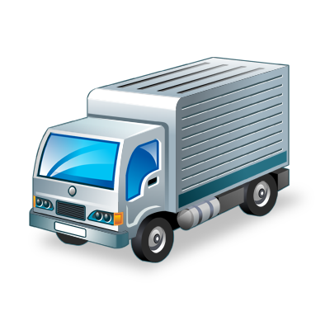
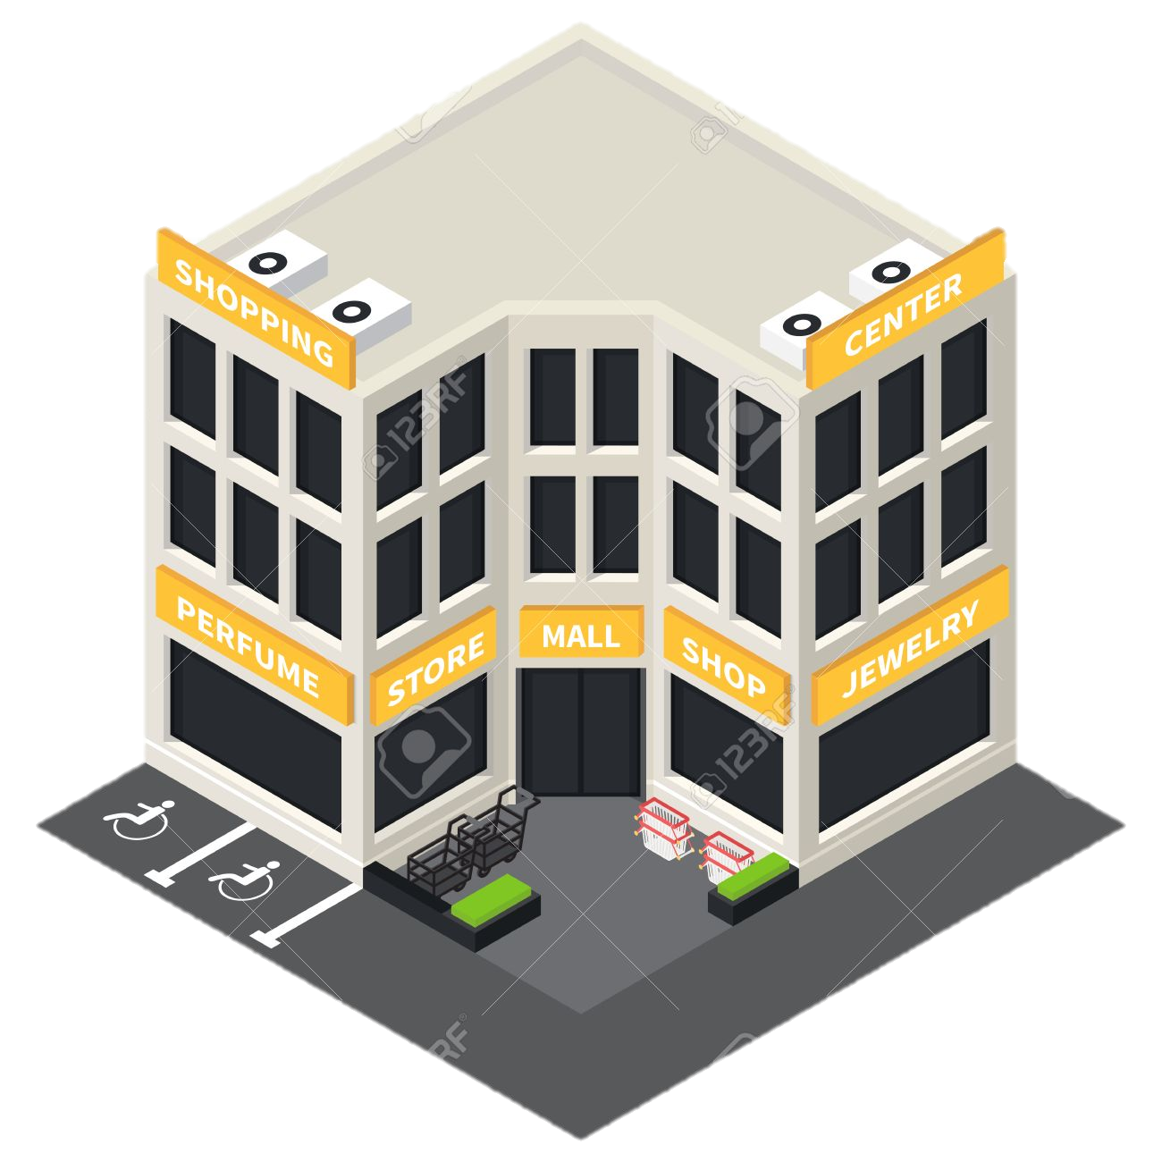


Bigger opportunity to expand Connected Insurance over segments
Once the base ecosystem and platform is ready for the construction site services, the platform will be extended to other business segments..
Commercial Property
Worker’s Compensation
Home Owners
Vehicle
Monitoring water leakage, pipe burst, pipe freeze, gas leakage.
Early warnings on hurricanes, hailstorms
Monitor theft, vandalism, unauthorized access
Fire and smoke detection
Monitoring the vitals of employees working in hazardous environment
Check whether the employee is adhering to safety standards like safety belts, helmets, jackets etc.
Monitoring shift time to ensure the employee is not working beyond the working hours
Monitoring water leakage, pipe burst, pipe freeze, gas leakage.
Theft monitoring
Fire and smoke detection
Vehicle diagnostics based potential failure alerts
Provide alerts for driving behavior like harsh breaking, over speeding, fast lane changing etc.

Slide 8
PoC Approach for Construction Property

Slide 9
Connected Insurance for Construction Property PoC Objective
Hartford wants to leverage data from smart construction property sensors installed at affiliated 2-3 construction properties to
Detect water-leak
Detect smoke
Predict equipment or device failure
Real-time data would help in demonstrating the art of possibility to do disaster prevention & mitigation and predict the overall risk reduction for construction property product.
Objective of the POC:
Gather real time data from selective smart sensor vendor(s) cloud and store it in Cognizant’s Connected Places (1Facility) offering deployed on top of Microsoft Azure instance.
Risk Engineer Dashboard - Provides Risk quality score arrived based on accessing the various sensor data
Underwriter Dashboard - Provides a summary view for the UW to make better decisions. Data includes statement of value, risk accumulation analysis, geo risk analysis
Key Actors:
Actuary / Product Development Team (Insurance Provider)
Affiliated construction property owners (Customers)
IoT sensor vendors (3rd Party Vendors)
Assumptions:
* Sensors in scope are already installed in the insured construction properties by affiliated construction property owners

Slide 10
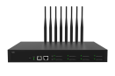
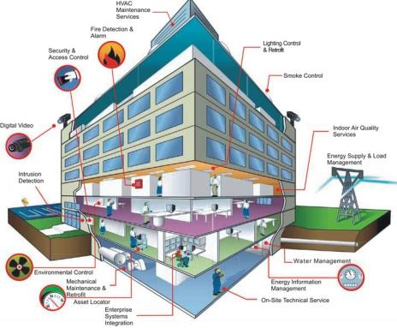

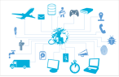
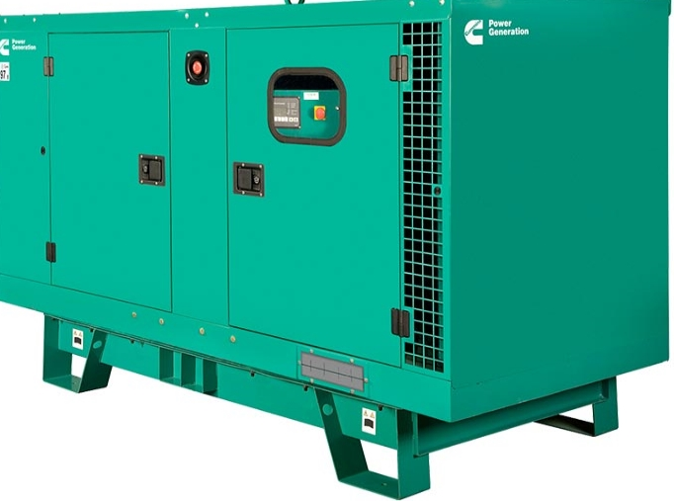
Construction Property PoC Approach – Potential Use Cases & Scope
Insured Construction Property equipment with smart sensors
Access to smart sensors data over cloud or API
Models & Patterns
Customer, B2B
Real-time data
Notifications and Alerts
Proactive Risk / Loss Identification
Insured
Water Leak
Dashboard & Reporting
Smoke Detector
Real-time Machine Learning
Customer system integration
External systems
Equipment Telemetry
Secure Building Integration
Legend
PoC Use Case Sensor
PoC Scope
Future Scope

Slide 11

Building Blocks of Connected Insurance
Scalable and robust architectural components which can be extended to multiple use cases
Device
Connectivity
Aggregation
Platform
Application
Integration
Engagement
Smart Construction (Building) Devices
Communication
Edge Gateway / Hub
Platform Services
Business Driven Apps
Enterprise Apps
Presentation
Water Leak Detection / Pipe freeze Sensor
CHANNELS
Wi-Fi
Ethernet
Bluetooth
Agents & Communications
Security – Authentication & Authorization
Alerts / Notification
Management
Ticket Management
Water Leak Detection
Telemetry Sensor
Device & User Management
Product Development
Device Management
Smoke Detection
Smoke Sensor
Stream Processing
Underwriting & Rating
Orchestration &
Edge Analytics*
Configuration & Content Management
Equipment Failure
Customer Service
Mobile, Web
Smart & safety Wearables
PROTOCOLS
HTTPS
COAP
AMQP
BACNET
MODBUS
Rule Engine
Surveillance/Intrusion
Detection
Policy Administration
1Facility Dashboard for Insurance Provider
Smart Camera – Security & Surveillance
Processing &
Hosting
CHANNELS : VPN / Private Internet Gateway
Device Twin
Claim Services
Building Automation Systems
Digital Twin
Authentication
Aggregation & Normalization
Revenue
Management and Billing
End user / Customer Mobile App
Door Lock
Data Storage / Data Management
Remote Monitoring / Remote Configuration
Compression &
De-duplication
Log Management
Customer Management
HVAC, Controller Systems
Predictive Maintenance of Devices
Smart Devices / Equipments
Rules Engine
Analytics Library
Services
HIERARCHY
Networks
FOG
Machine Learning based
Decision Systems
Digital Field Service
Smart Meter &
Smart Plugs
Edge CEP
Hot Path Analytics
Data Analytics
Partner Services
Temperature, Humidity Sensor
Video /Image Analytics
Cold Path Analytics
Utility Service Providers
Components highlighted in green are only applicable for Proof of Concept (PoC) Scope

Slide 12






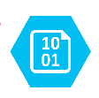





Reference Architecture of Connected Insurance on Microsoft Azure
Data Sources
Device Connectivity & Management
Processing
Storage
Integration
Presentation
Service
Fabric
Meta Data
Water Leak Detection Sensor
3rd party Sensor Provider / Vendor Cloud
End user / Customer Mobile App
Water Leak Detection
(Floor level, Zone level)
Azure SQL
Telemetry
Sensor
Smoke Detection
(Floor level, Zone level)
Real time Data
Email/SMS
Equipment Failure
(On/Off, Utilization)
Timescale DB
Smoke
Sensor
Files and Assets
Notification Hub
Limited Rulesets (Alerts & Notifications)
Asynchronous Messaging
1Facility Dashboard for Insurance Provider
Smart Camera
Blob Storage
Fast and Frequent Data
Data Bricks
Azure Service Bus
Temperature
Sensor
Redis Cache
Wearables

Slide 13
PoC Implementation Approach
WEEK 1
WEEK 2
WEEK 3
WEEK 4
WEEK 5
WEEK 6
WEEK 7
WEEK 8
Cognizant’s Connected Places (1Facility) Platform Customization
Customize 1Facility Platform for Hartford
AD integration
Data model customization
Data volume analysis
Data Extraction & Integration
3rd Party Vendor Cloud services data integration
3rd Party Vendor API services data integration
Dashboard & report structuring
Web UI & Mobile UI
UI Design
Web services Development
UI Page
Development
SDK Integration
Testing & Support
Integration Testing
UI Testing
UAT Support
Warranty Support
(2 weeks)
PoC Retrospection & Analysis

Slide 14
Next Step :Scale & Operationalize Connected Insurance Platform through Nerve Center
Create a scalable base platform and implement a Pilot on Water Leak
Expand for other use cases related to building and structure
Expand to add construction equipment & worker safety
Scale & Commercialize
.
Expand connected insurance over other segments
IOT deployments, while providing a platform to integrate the entire ecosystem require an enterprise level support/operations layer
( a “ Nerve Center”) to maximize customer experience and business value.
Connected Insurance Platform
Nerve Center
Device connectivity
Device enrollment
Data streaming
Data visualization
Software updates
Authentication
Device support for end user
End user application support
Customer experience management
Business operations support
Platform support
Data analytics
Nerve Center helps streamline the support/operations by addressing the following challenges:
Device, Platform
Operating conditions
Customer issue resolution
Business model aspects
Heterogeneous devices/sensors
Connectivity challenges
Platform evolution and support
Product evolution and support
Distributed assets, outside enterprise boundary
Exposure to connectivity issues outside sphere of influence
Customer issue management
Customer support
Issue triaging across org. boundaries
Vendor/ 3rd party management complexities
Divisions/business bandwidth to support at scale
Product variance- low volume/high volume
Leveraging data for competitive advantage

Slide 15
Thank You

Slide 16
Raw sensor data from Water Leak Sensors (Provisioned directly from a Vendor Cloud)
DataMessageGUID | SensorID | Sensor Name | Date | Value | Formatted Value | Battery | Sensor State | GatewayID | Alert Sent | Signal Strength | Voltage
2ca99f4a-ee59-4964-bb42-31d37e54bb04 | 458313 | West Wing Pantry | 8/23/2019 21:11 | 0 | No Water Present | 100 | 0 | 945850 | FALSE | 61 | 2.53
385c44de-7c87-44db-8ff2-44713ebd0c8e | 458313 | West Wing Pantry | 8/23/2019 20:56 | 1 | Water Present | 100 | 1 | 945850 | TRUE | 62 | 2.53
b786fbfe-fcf9-4338-b7f1-1d25f295a82b | 458313 | West Wing Pantry | 8/23/2019 20:41 | 0 | No Water Present | 100 | 0 | 945850 | FALSE | 62 | 2.53
539df337-7311-465e-ba23-e6af67a5bec4 | 458313 | West Wing Pantry | 8/23/2019 20:26 | 0 | No Water Present | 100 | 0 | 945850 | FALSE | 61 | 2.53
fcdb7397-4c0c-41ae-92c9-4830f585a7fd | 458313 | West Wing Pantry | 8/23/2019 20:11 | 1 | Water Present | 100 | 1 | 945850 | TRUE | 61 | 2.53
23de433f-f3bb-494f-9c76-c51f40ff4429 | 458313 | West Wing Pantry | 8/23/2019 19:56 | 1 | Water Present | 100 | 1 | 945850 | FALSE | 61 | 2.53
f9fe3e9e-04d2-4bd7-b6ce-55d1995cc7d7 | 458313 | West Wing Pantry | 8/23/2019 19:41 | 0 | No Water Present | 100 | 0 | 945850 | FALSE | 55 | 2.53

Slide 17






Cognizant’s Approach for Connected Insurance Solution at Scale
Strategic System Integrator
Turnkey Solution Provider
Turnkey Solution Provider
Solution Development
End to End Central Support House
IoT Platform / Device
Vendor Ecosystem **
Installation & Commissioning at Hartford Construction Properties **
Leverage Cognizant’s Connected Places Solution Accelerator – 1Facility
Will customize & design the existing 1Facility offering for Hartford’s Connected Insurance Program
Provide L2 and L3 support
Ensure end to end availability of the solution
One point of operational contact for all IoT Platform, hardware, software solution stack
IoT Platform Vendors
Cognizant will work with the Hartford identified partners to do global deployment & maintenance of connected Insurance Program
Hardware Vendors
Cognizant’s Responsibility
Joint Responsibility

Slide 18

















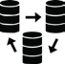

1Facility Reference Architecture
Real Estate
Mgmt.
Space
Mgmt.
Lease
Mgmt.
Facility Maintenance
Energy Mgmt.
3RD Party Services
LOCATION SERVICE
WEATHER DATA
TRAFFIC
DATA
RISK PORTFOLIO
BIM
LEASE MGMT.
IWMS
SERVICE MGMT.
CRM
ERP
Cognizant Connected Places
FIELD TECHNICIAN
SECURITY AUTOMATION
CONNECTORS / INTEGRATORS
LIGHTING CONTROL
CORE SERVICES
BUSINESS MICRO SERVICES
APPS
DATA INGESTION
STREAMING ANALYTICS
ALERTS
ANALYTICAL ENGINE
WORKFLOW
RULES ENGINE
MACHINE LEARNING
ENERGY MANAGEMENT
FOOD SAFETY
FIELD SERVICE OPTIMIZATION
LAYOUT & SPACE MGMT
SAFETY & SECURITY MGMT
ASSET TRACKING
RISK PROFILING & MGMT
FIELD SERVICE APP
FACILITY MANAGER
CCTV
POWER CONTROL
OPERATIONAL DASHBOARD
BAS
(or)
BMS
ALARM MONITOR
Cognizant Connected Places
COMMAND & CONTROL
OPERATIONS MGMT. TEAM
PORTAL
PA SYSTEM
GATEWAY
BUILDING ANALYTICS
HVAC
FINANCIAL PLANNER
Occupancy Control
Building Data
(Raw Data)
Data Integration
Advanced Analytics
NEW SENSORS

Slide 19

Risk Avoidance for Commercial Buildings
For European insurance firm
Advance Risk
Selection
without engineering visit
The Challenge
Leading insurer required to
Reduce claims in Commercial Building Insurance.
Not all relevant data held within Building Management System.
Quantity and mix of sensor data differs between buildings.
Centrally accessing data securely.
Our Approach
Connected Smart Commercial Buildings solution fully owned and delivered by Cognizant in PaaS model
Utilize latest IoT sensors to securely capture building telemetry data, consolidates and interprets data from each building’s monitoring systems.
Notification Service to escalate Critical issues.
Benefits
Advanced risk selection without risk engineering visits
Early loss detection/ prevention
Usage pricing rewarding well managed buildings
Sophisticated pricing techniques leverage building data throughout the policy lifecycle.
Improved Health and Safety and reduced risk of personal claims
Sophisticated pricing
techniques
leverage building data throughout the policy lifecycle
Early loss
detection/ prevention
Notes:
Insight from BAS allow risk mitigation services
Drive revenue from new products
Generate new value through actionable insights
Pro-active risk mgmt. and claims mitigation
Informed pricing increase competitive buildings cover
Partnering to harness data to monitor property’s “well being” & risk profile

Slide 20




Insurance Propositions
Enhanced Underwriting - provide additional data to enhance pricing and risk assessment
Risk Management – provide insight in to building use and management to improve insight and reduce potential risk
Claims Mitigation – direct loss identification, intervention and prevention
Client Value Add – new sources of value to the client relationship; energy improvements, asset failure prevention, maintenance quality assessment

Slide 21
Parameters from Buildings
# | Name | Description
1 | Water Meter Reading | Event if water consumption higher than average outside of normal operational hours
2 | Alarm Inhibit | Event if Alarms inhibited for more than 2 hours
3 | Water Pipe Temperature | Event if Temperature less than 1 degrees or greater than 95 degrees Celsius
4 | Alarm Detectors | Event if smoke alarm, fire alarm, or other monitoring systems become offline for more than 1 hour
5 | Maintenance Monitored | Event on building fault & fault resolution - faults & resolution included in periodic building maintenance report
6 | Emergency Power Fault | Event if emergency power fault continues for more than 8 hours
7 | Systems Air Temperature | Event if Temperature less than -10 degrees or greater than 80 degrees Celsius
8 | Humidity | Event if humidity is less than 30% or greater than 60%
9 | Water Pressure | Event if water pressure is low, a potential for water leak
10 | Electric Meter Reading | Event if Power consumption higher than average outside of normal operational hours
11 | Frost Protect | Event if Frost Protect Failure during cold conditions
12 | Lift Alarm | Event on Health and Safety, people trapped in lift outside of normal hours
13 | CO2 Level | Event on Room carbon dioxide reading higher than expected (above safety limits)
14 | Water Evacuation Fault | Event if water evacuation fault continues for more than 2 days
15 | Window | Event on Health and Safety& Building Efficiency – window open outside normal hours
16 | Room Temperature | Event if Temperature less than 15 degrees or greater than 30 degrees Celsius
17 | Out Of Hours Usage | Event if Consumption is higher than normal during Out of Business hours
18 | Factory Humidity | Event if air is too humid / moist or too dry
19 | Electric Consumption | Event if Electricity consumption is higher than daily average
20 | Motor Power | Event on Health & Safety / mechanical issues, if motor power output is too high
21 | Motor Current | Event on Health & Safety / mechanical issues if motor current is too high
22 | Motor Voltage | Event on Health & Safety / mechanical issues if motor voltage is changing too much (tolerance factor)
23 | Electric Consumption Office | Event if Electricity consumption is higher than daily average during office hours
24 | Water Consumption Daily | Event if water consumption is higher than daily average

Slide 22
Parameter Patterns by Buildings
Building | Patterns
Building #1 | Frost Protect
 | Maintenance Monitored
 | OOH Usage
 | System Air Temperature
 | Water Pipe Temperature
 | Water Pressure
Building #2 | Room Air Temperature
Building #3 | CO2 Level
 | Factory Humidity
 | Humidity
 | Room Temperature
 | Window Open OOH
Building | Patterns
Building #4 | Alarm Detectors
 | Alarm Inhibit
 | Electric Consumption Office
 | Power Consumption OOH
 | Emergency Power Fault
 | Humidity
 | Lift Alarm
 | Maintenance Monitored
 | Systems Air Temperature
 | Water Consumption Daily
 | Water Evacuation Fault
 | Water Consumption OOH
 | Water Pipe Temperature
Building #5 | Electric Consumption
 | Electric Consumption OOH
 | Frost Protect
 | Motor Current
 | Motor Power
 | Motor Voltage
 | Systems Air Temperature
 | Water Consumption Daily
 | Water Meter Reading

Slide 23
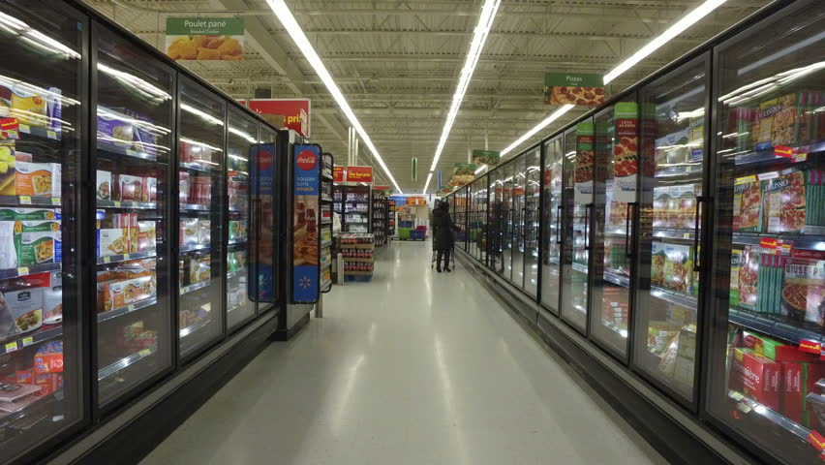

Energy Management for a Leading Retailer
10%
The Challenge
Every year, for one of the largest retail chain in US, a loss of nearly $2B is occurring due to food wastage –primarily due to the equipment failures. From store’s Refrigerators, HVAC, Lighting and Trashing system, the backend system receives unfiltered events & alarms related to abnormal system behaviors. But the issues are:
High volume of alarms
Inability to respond to low priority alarms - 3100 monitoring points
Manual work-order generation
Inability to predict and forecast failures
Our Approach
Cognizant created a configurable Alarm & Rule System - 2000 business rules
Retrieving the sensor parameters in every 5 minutes interval
Intuitive UI which comprises of task management, visualize the sensor trends and comparisons.
Ability to enable/disable the rules based on stores/rules specific
Benefits
Real-time notifications
Auto Work order creation
Extensible and scalable architecture
~85% work orders scenarios are handled automatically.
Reduce Work Order Creation time from 36hrs to ~4hrs, increase food shelf life.
Reduced response time from 7 hours to ~5 minutes
Reduction in
Food wastage
$18M
Operating Cost
Reduction (Expected)
84%
Quicker Response
Time
23
© 2019 Cognizant
Notes:
Customer: Walmart
Geography: North America
Vertical: Retail & Consumer Goods (RCG)
Service Line: Commercial
Sub Practice: IoT
COTS: Microsoft Azure
Nature of Work: Implementation
Delivery PoC: <>

Slide 24





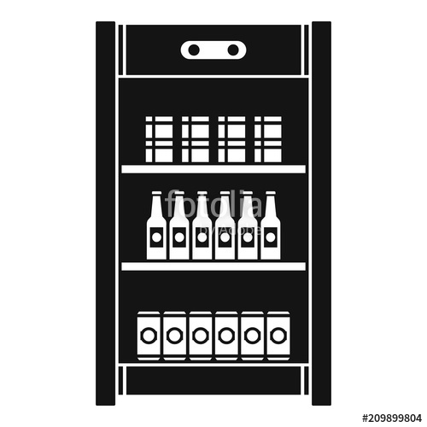

Complexities & Challenges
Different Control Systems across the stores (Novar, Danfoss, Opus, Emerson)
Legacy hardware controllers, no longer supported by the vendors
Device
Sensors
Parameters
COMPLEX DATA POINTS
Average Record Size : 250-300 (In Bytes)
Records Per Day : 525,096,000
Data Per Day : 135 (In GB)
Data Per Year : 143 (In TB)
SYSTEM & DATA COMPLEXITY
~737 Million transactions per day
~100 Million alerts events per year
~0.4 Million work orders per year
36 Hours cycle time for a work order
3100 monitoring points
2000 business alerts
7 years data storage
884
114
Refrigeration
Controllers &
Sensors
PER STORE FACTS
Only 1 legacy controller (90% stores)
~850+ sensors per store
Controllers : NOVAR (EP2, Lingo, OPUS), Danfoss, CPC Emerson

Slide 25
Parameters from HVAC or Refrigeration in Stores / Warehouses / Manufacturing Plants
SENSOR PROPERTIES
Rack Name
Rack Label
Rack Status
Country Code
Store Number
Controller Type
Network Name
Module Name
Module Label
Module Status
Module Type
Sensor Name
Sensor Label
Sensor IO Type (Analog or Digital)
Sensor Reading Value (Celsius, Pascal)
Sensor Reading Type (Input or Output)
Sensor Reading Response Log Date Time
Sensor Reading Request Log Date Time
HVAC Flag (HVAC or Refrigeration)
Low / High Cut In or Cut Out
TEMPERATURE PROPERTIES
Log Date Time
Module Name
Sensor Name
Sensor Value
Lower Limit
Upper Limit
Dual Temperature Mode
Low / High Cut In
Low / High Cut Out
Expected Operating Value
Deviation
Last Defrost Time
Defrost Duration
Defrost Temperature

